Slide 1
Object detection with YOLO
Neural networks

Slide 2

What is Machine Learning?
Smart
Future
Artificial Intelligence
Deep Learning
Big Data
Data Analytics
Data Science
Data Mining

Slide 3
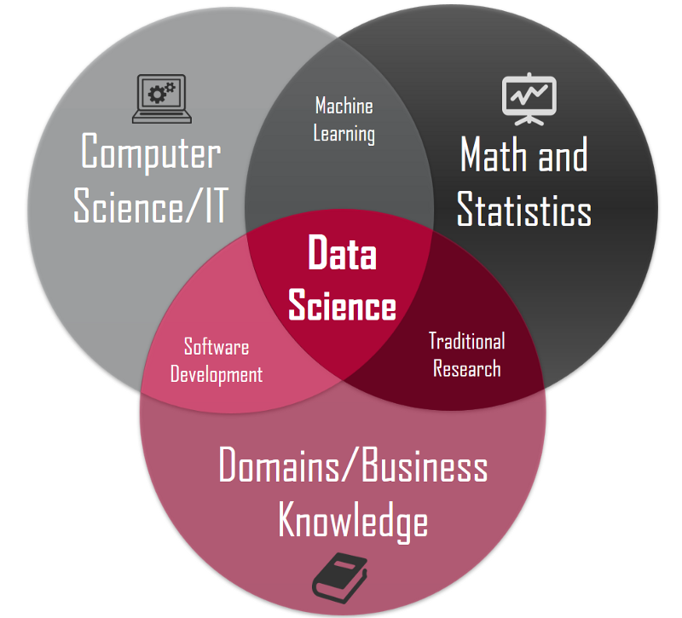
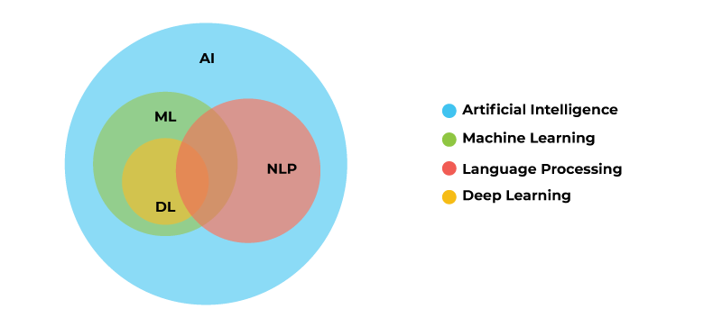
The overlapping of domains and sub-domains

Slide 4
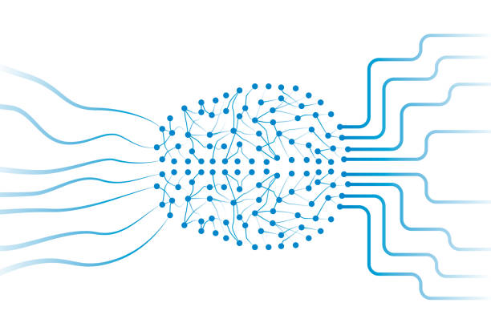
Neural Network Basics
A neural network is a series of algorithms that endeavors to recognize underlying relationships in a set of data through a process that mimics the way the human brain operates. In this sense, neural networks refer to systems of neurons, either organic or artificial in nature.

Slide 5


Slide 6
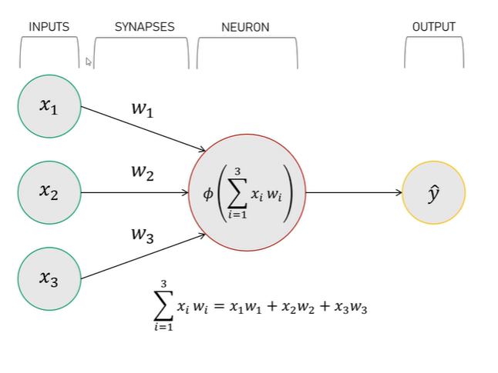
Mathematics of Neural Networks

Slide 7
Straight line equation
ax+by = c
Let’s substitute x by x1 and y by x2
a*x1+b*x2=c
Let’s substitute a by w1 and b by w2
w1*x1+w2*x2 ≈ c

Slide 8
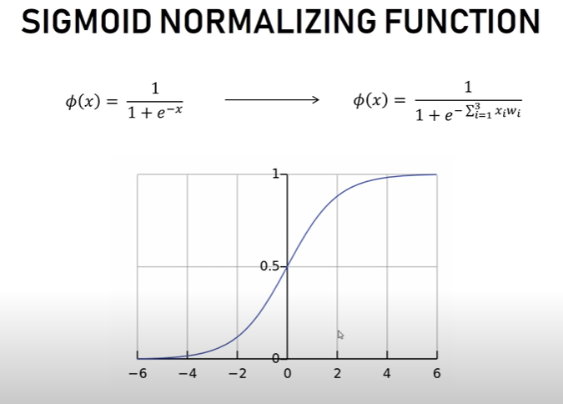
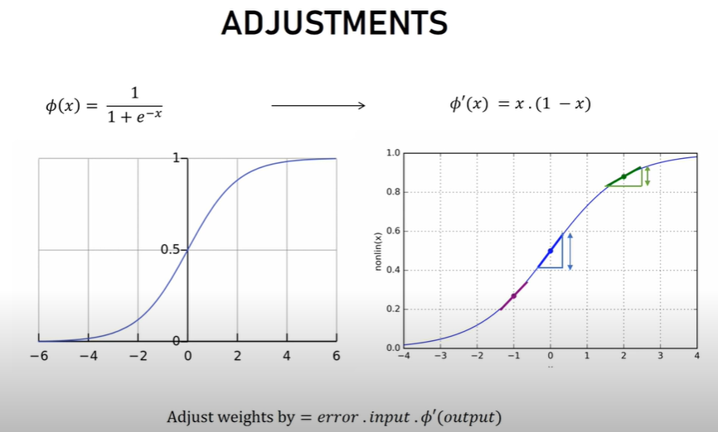
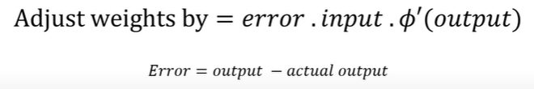

Slide 9
Problem Set
SNO. | INPUTS | OUTPUTS
Example 1 | 0 | 0 | 1 | 0
Example 2 | 1 | 1 | 1 | 1
Example 3 | 1 | 0 | 1 | 1
Example 4 | 0 | 1 | 1 | 0
New Situation | 1 | 0 | 0 | ?

Slide 10
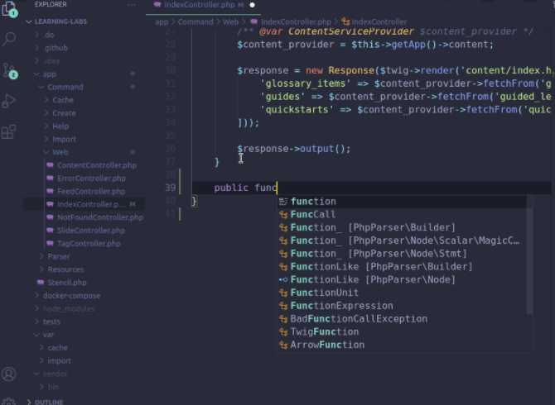
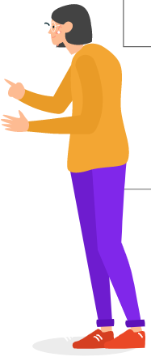
Let’s get started with hands-on-coding of NN

Slide 11
YOLO

Slide 12
Dataset
A data set is a collection of data. In Machine Learning projects, we need a training data set. It is the actual data set used to train the model for performing various actions
Custom Model
Generate Model File
Pretrained Model
Gather Datasets
Preprocess the data
Train and Test the model
Application or production

Slide 13
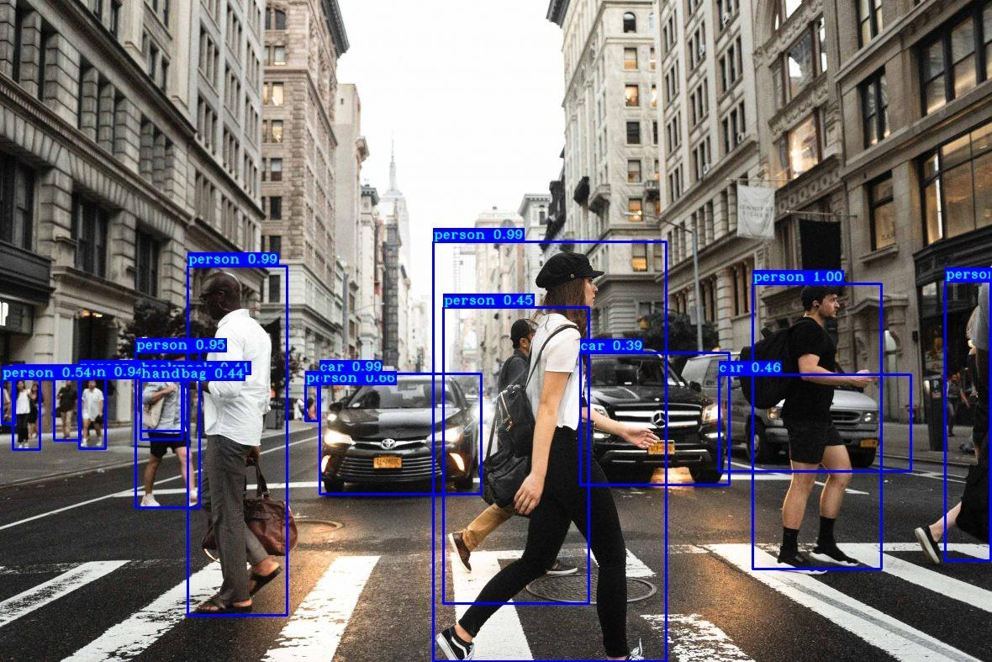
YOLO
YOLO is an abbreviation for the term ‘You Only Look Once’. This is an algorithm that detects and recognizes various objects in a picture.
Object detection in YOLO is done as a regression problem and provides the class probabilities of the detected images
YOLO algorithm employs convolutional neural networks (CNN) to detect objects in real-time

Slide 14
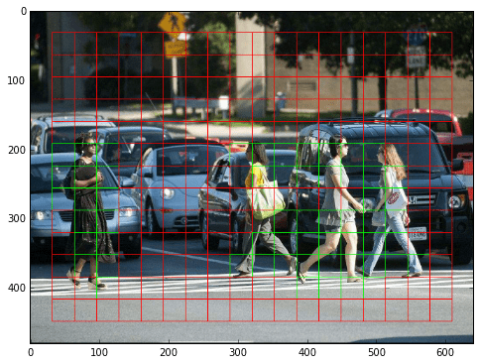
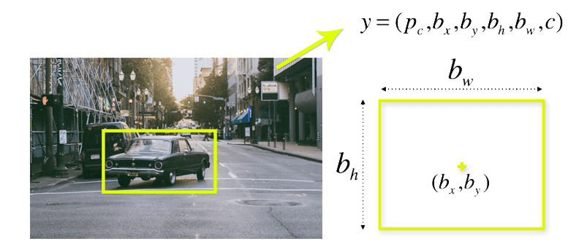
Working of Yolo Model
Residual block
The following image shows how an input image is divided into grids
First, the image is divided into various grids. Each grid has a dimension of S x S.
Bounding box regression
A bounding box is an outline that highlights an object in an image.
It consist of:
Width (bw)
Height (bh)
Class(c)
Class Probability(pc)
Bounding box center(bx,by)

Slide 15
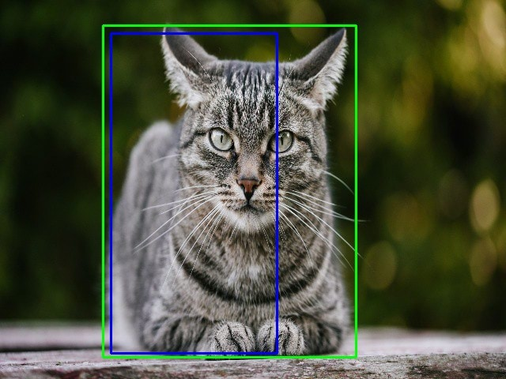
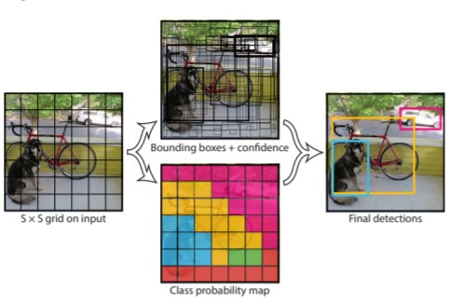
Working of Yolo Model
Intersection over union (IOU)
Intersection over union (IOU) is a phenomenon in object detection that describes how boxes overlap. YOLO uses IOU to provide an output box that surrounds the objects perfectly.
It is combination of three Techniques

Slide 16
Labelling tutorial
STEPS
Create folder name Custom_data in download directory in your desktop
Add Imageye Extension into chrome
https://chrome.google.com/webstore/detail/image-downloader-imageye/agionbommeaifngbhincahgmoflcikhm?hl=en
Rename the images in sequence
Download labelImg tool for labelling
https://tzutalin.github.io/labelImg/
Label images

Slide 17
YOLO Inputs for custom model
600 text files & 600 images
Clone Darknet and make changes to cfg and make file
Classes.txt
Train/test split
Darknet conv file download

Slide 18
Thank You
Himanshu Bobade
@bobadehimanshu
https://www.linkedin.com/in/himanshu-bobade-059a071a8/
Aneesh Gupta
@aneesh__03
https://www.linkedin.com/in/aneesh-gupta-7955221a6/

